Slide 1
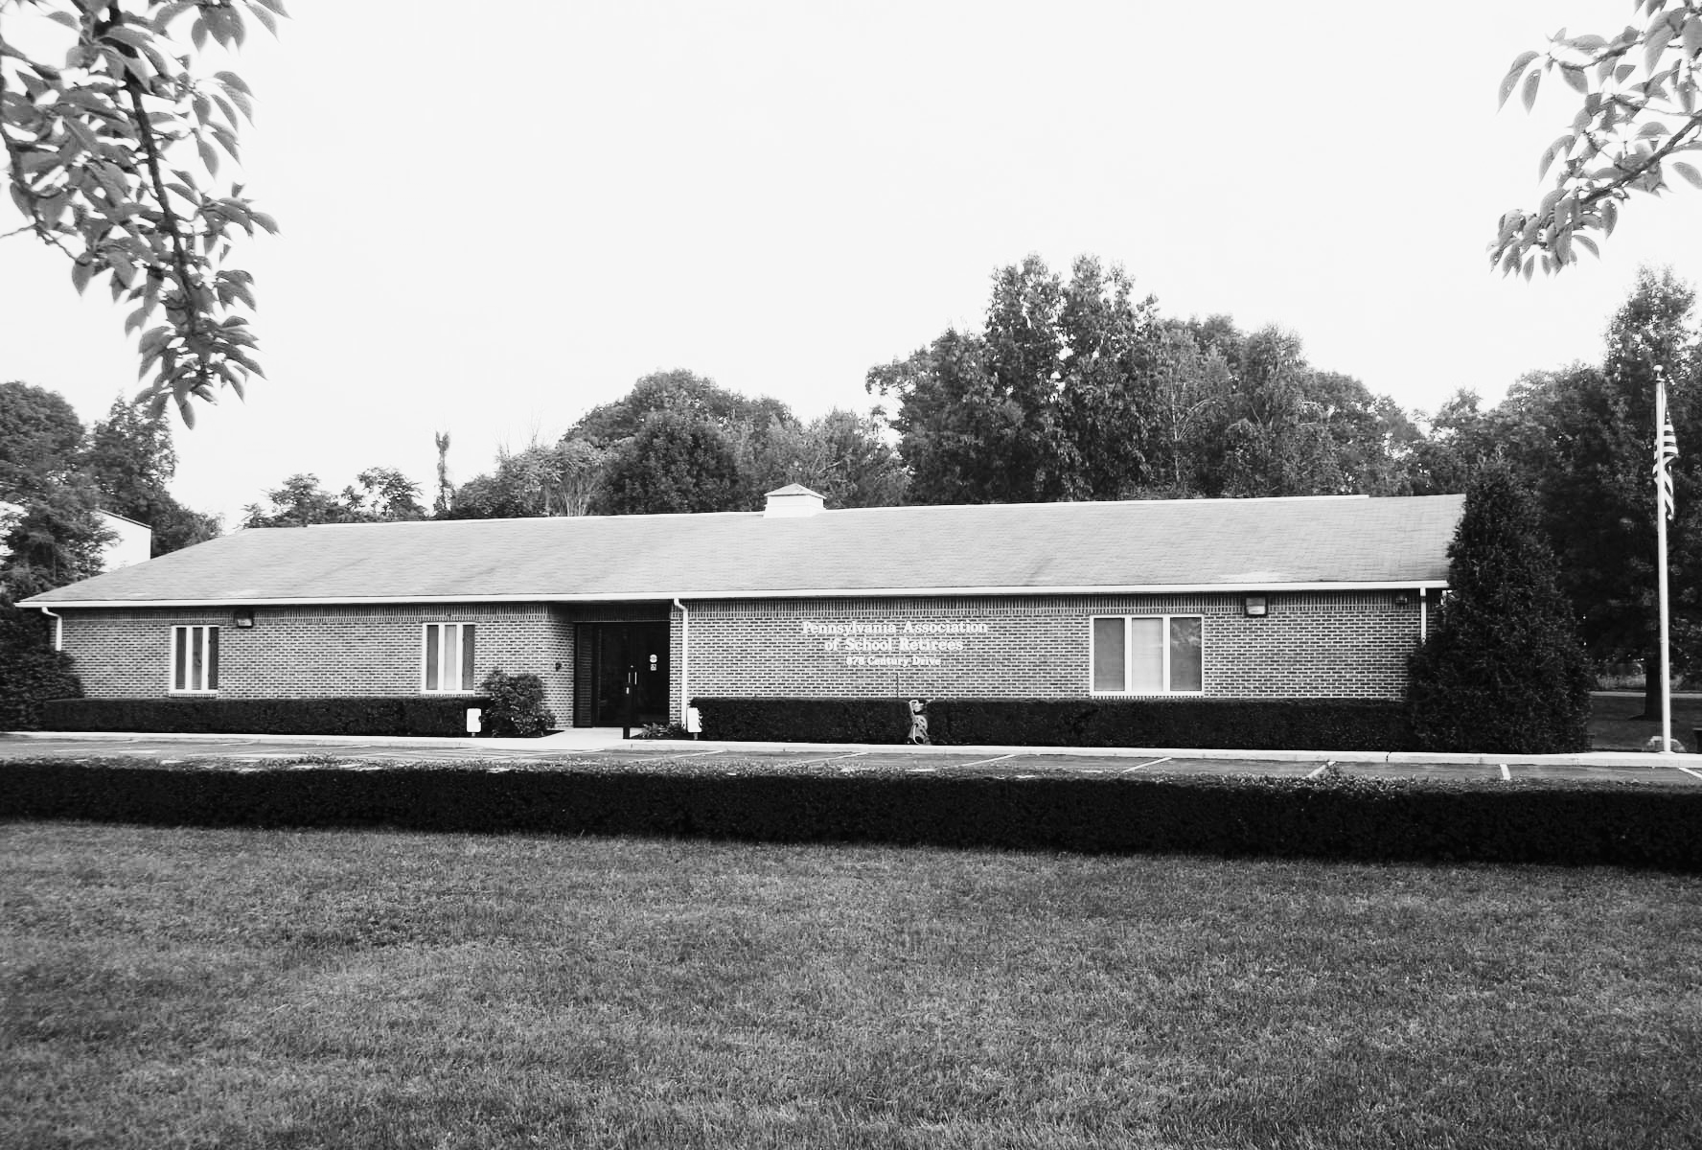

WELCOME!
WE’RE SO GLAD YOU’RE HERE

Slide 2
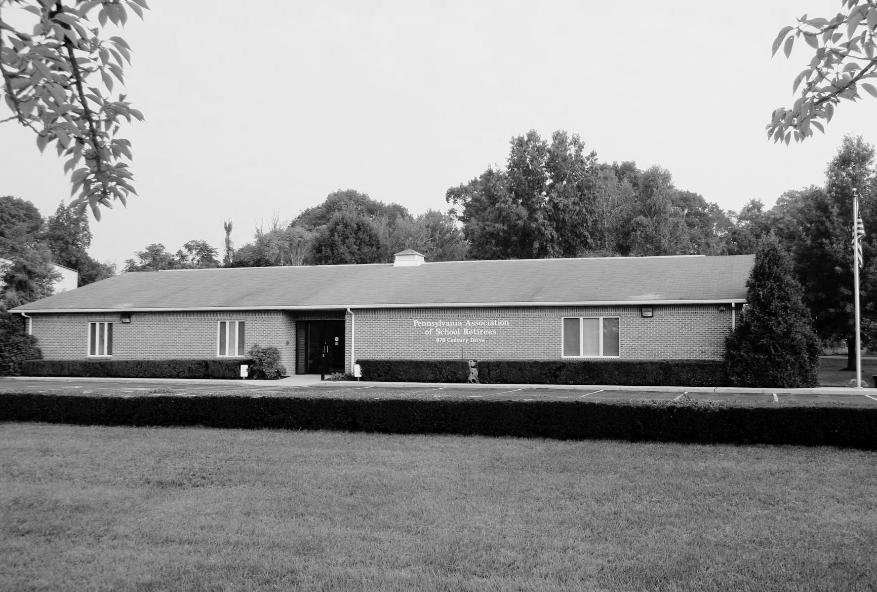


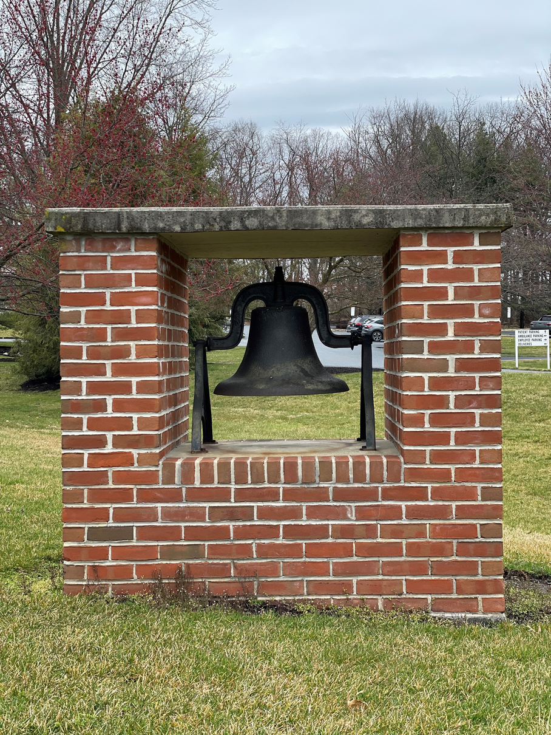
Who We Are
Founded on December 28, 1937, by a group of 9 retired educators
Comprised of a state association and local chapters across Pennsylvania (and a few out-of-state chapters)
Our purpose is “to serve others in need and help one another enjoy retirement.”
Governed by a 19-member volunteer Board of Directors from across Pennsylvania
Driven by topic-focused committees, such as:
Legislative Advocacy
Educational Support
Community Service
Supported by a dedicated staff of 7 based in Mechanicsburg, PA

Slide 3
Why Us?
We are the Association that consists of, is governed by and works exclusively to promote the interests and serve the needs of ALL people who retired from the public schools of Pennsylvania.

Slide 4
Legislation Advocacy
PASR is the only organization dedicated solely to the benefit of Pennsylvania school retirees
Advocates to protect and improve PSERS benefits for all school retirees
Maintains one of the largest grassroots lobbying networks in Pennsylvania:
Over 800 volunteers serve on legislative contact teams
Volunteers regularly meet with legislators to represent retiree interests
One of the few organizations advocating for a Cost-of-Living Adjustment (COLA) for PSERS annuitants
House Bill 411 is the first COLA-related bill in over 20 years to pass through the Pennsylvania House of Representatives

Slide 5
Social Opportunities
Social connection is one of the top reasons members join PASR!
Reconnect with former colleagues and make new friends in retirement
Gatherings often include:
Luncheons, reunions and special events
Opportunities to volunteer and give back together
Travel with PASR! Enjoy trips organized at both the state and chapter levels:
Explore destinations in the U.S. and abroad
Past trips have included places like Niagara Falls, Colonial Williamsburg, Ireland and Italy
Find full trip details at www.pasr.org under “Trips with PASR”
Check out our website calendar for upcoming day trips and group travel opportunities!

Slide 6
Giving Back
PASR members continue serving their communities beyond the classroom
Local chapters organize service projects such as:
Supporting local schools and food banks
Donating books to libraries
Sending supplies to active-duty military
Assisting elderly individuals in need
Awarding student scholarships and teacher grants
Chapters independently lead projects based on local needs
Raised $44,000 for Feeding PA in February 2021
Raised over $30,000 in February 2024, plus thousands more donated locally
$5,000 Stock the Classroom Grant (2024) awarded to Dylan Fedell, Physics Teacher at Palisades High School, for a hydroponics program—first-time applicant and a big success!

Slide 7
LET’S TALK
MEMBER BENEFITS!

Slide 8

Discounted Services for Members
Dental & Vision Coverage
Health & Wellness Discounts
Financial Services
Home, Auto & Life Insurance
Elder Law Attorney Discounts
Wholesale Club Discounts
Travel Services & Discounts
Technology Discounts
Amusement Park/Entertainment Discounts
Home Energy Services & more!
*you must become a member to utilize our benefits and discounts*

Slide 9


Dental Insurance
Dental Insurance with United Concordia
Most Medicare plans do not include dental coverage
As a nonprofit, PASR offers reduced-rate insurance plans exclusively for members
The United Concordia dental plan has been offered since 1991 and often pays for itself
Plan Highlights:
Year-round open enrollment — coverage starts the first of any month
Available for members, spouses and dependent children
Visit any dentist, but in-network providers offer the most savings
Preventive care (exams, cleanings) is 100% covered in-network
Basic services (e.g., fillings, root canals, extractions) covered at 60–100%
Major services (e.g., dentures, crowns, bridges) covered at 50% in-network
Annual max benefit: $2,100 or $2,500 per person (vs. $1,400 with HOP MetLife)

Slide 10
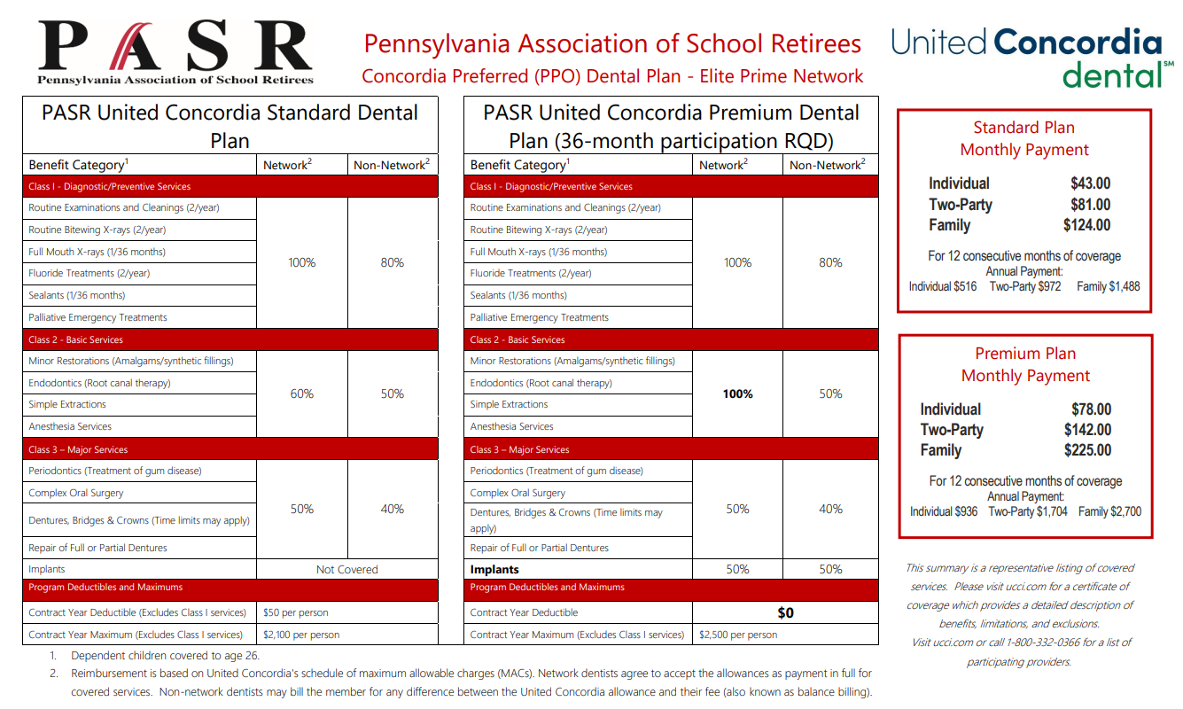

Slide 11

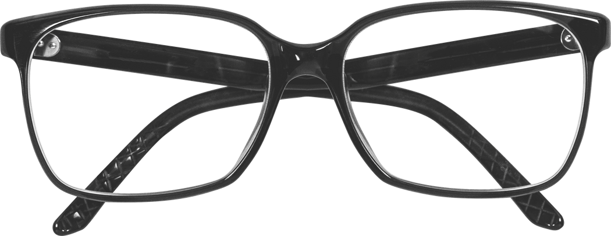
Vision Insurance
What They Offer:
Access to a blended network of independent eye doctors and national/regional retailers
Helps maintain eye health and clear vision
Paid-in-full coverage for eye exams, glasses and contact lenses with in-network providers
Plan Highlights:
Designer frame collection fully covered in-network
Choose from popular contact lenses through Davis Vision’s Contact Lens Collection
One-year breakage warranty on eyeglasses at no extra cost
Broad provider choice, convenient locations and name-brand options

Slide 12
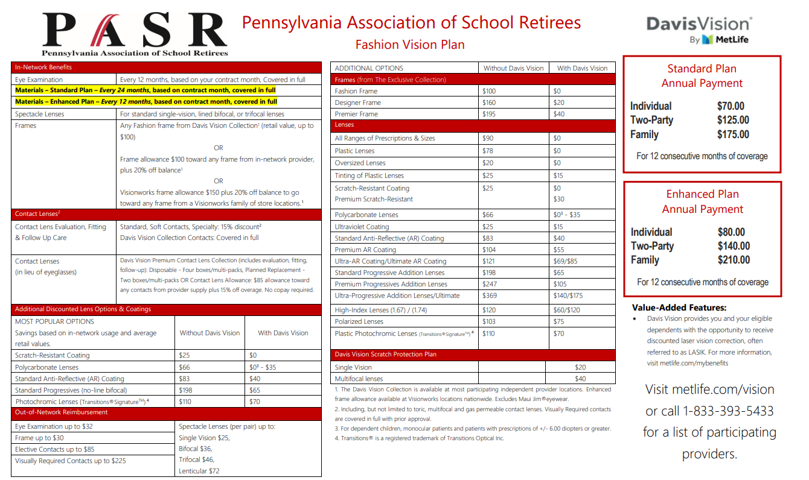

Slide 13







Health & Wellness
At PASR, we care about your well-being beyond retirement. That’s why we partner with trusted providers to offer our members access to affordable, high-quality health and wellness services that support your physical and mental health.

Slide 14


Financial Services
PASR is committed to supporting your financial peace of mind in retirement. Through trusted partners, we offer valuable services, expert guidance and exclusive discounts to help you manage your finances with confidence.
Securities and advisory services offered through LPL Financial, a registered investment advisor. Member FINRA/SIPC. PASR, Grove Wealth Management and LPL Financial are separate entities.

Slide 15




Home, Auto & Life Insurance
PASR is proud to partner with Grove Financial & Associates (GF&A). Through our partnership, GF&A is pleased to offer unique benefits that are exclusive to PASR members. Benefits include free, no-hassle reviews of existing policies and the availability of a PASR discount on new auto and homeowner policies with our select carriers, Westfield Insurance and Penn National Insurance.

Slide 16


Elder Law Attorney Discounts
Our members have access to a vetted and certified Elder Law Attorney who will help with Elder Law, Estate Planning, Estate Administration, Medicaid Planning and Disability Planning. PASR members receive a discount following a free consultation!

Slide 17


Wholesale Club Discounts

Slide 18




Travel Services & Discounts
Retirement is the perfect time to explore—and PASR helps you do it with ease and savings! From exciting day trips to unforgettable international adventures, we offer travel opportunities and discounts designed just for our members.

Slide 19




Technology Discounts

Slide 20










Amusement Park & Entertainment Discounts

Slide 21
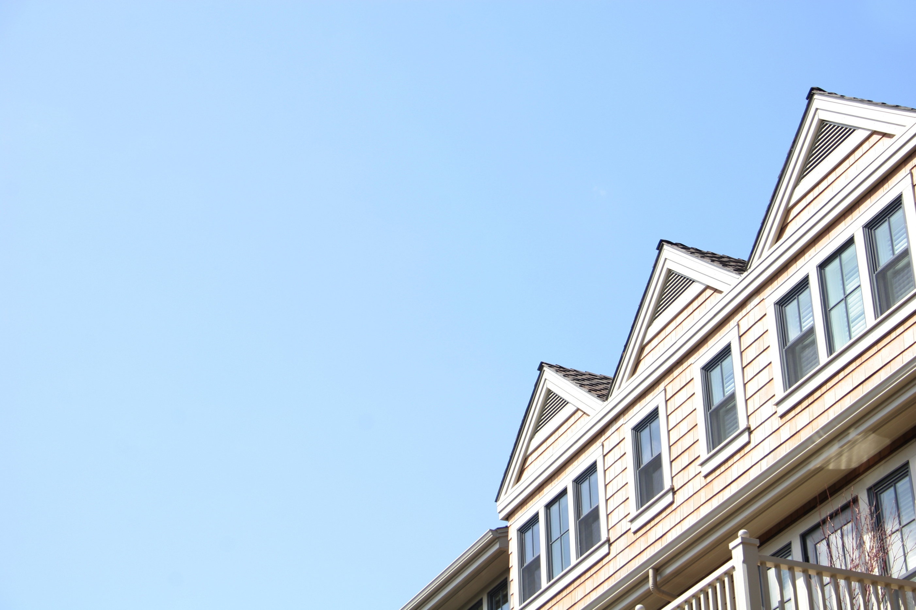


Home Energy Service Discounts

Slide 22




Other Services

Slide 23

Membership Types
Active (Annual, Life or Half-Life) Member
Associate Member
Retired under the Pennsylvania Public School Employees’ Retirement System (PSERS)
Retired under a public-school retirement system from another state
Retired from any educational Pennsylvania state-related institution (e.g., state universities or education agencies)
Eligible to vote and hold office
Not eligible to vote or hold office
A spouse of an Active PASR member
Any person who is interested in the work of PASR (Yes–anyone can join!)
Any active school employee

Slide 24

State vs. Chapter Memberships
State
Chapter
(Required to access key benefits like Dental and Vision Insurance)
Needed to purchase dental, vision and many state-level benefits
Can be paid annually ($60) or every 3 years ($150)
Lifetime membership available for $700
Half-Life membership option: pay half up front, remainder due one year later
Connects you to statewide resources, communications and advocacy efforts
Includes automatic eligibility to participate in state-sponsored trips, communications and events
(Optional and localized—perfect for community involvement)
Cost varies by chapter but is lower than state membership
Most chapters are organized by county or geographic area
Allows participation in local events, meetings, and service opportunities
Can be joined with or without State Membership
Does not provide access to dental, vision or state-level insurance benefits
Some chapters offer lifetime membership options

Slide 25
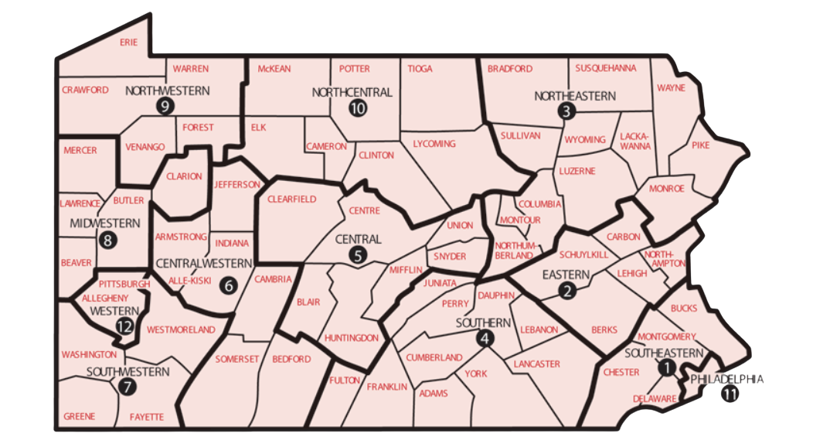

Slide 26


What else would you like to know about
?

Slide 27

STAY IN TOUCH!
Phone: (717) 697-7077
Hours: 8:30 a.m. to 4:30 p.m. (M-F)
Email: pasr@pasr.org
Website: www.pasr.org
Facebook: Pennsylvania Association of School Retirees (PASR)

